Slide 1
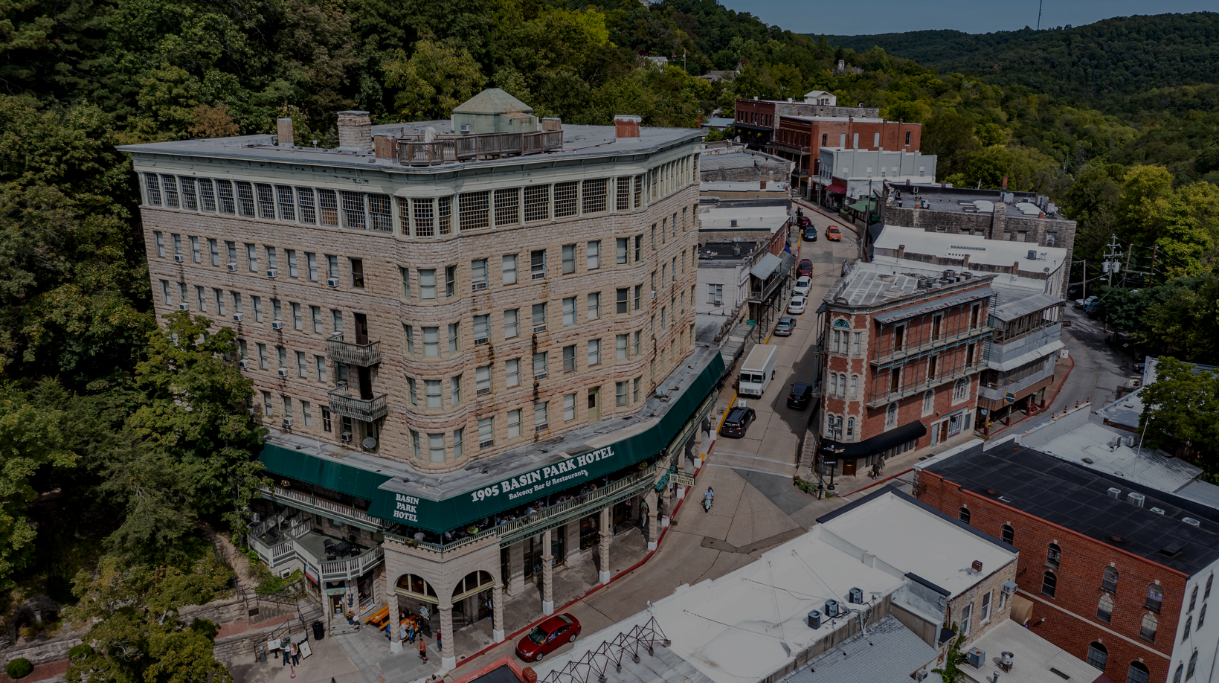

Presented to
EUREKA
SPRINGS
AGENCY PRESENTATION / YEAR TO DATE SUMMARY: OCTOBER 23, 2024

Slide 2
2024 Strategy
THE STUFF YOU’RE GOING TO
Creative Evolution
HEAR ABOUT
Media Performance
Website, Analytics & SEO
Public Relations
we’re ready to go!

Slide 3


A Quick Recap
(what we’ve been up to and where we’ve been)
Notes:
Tay / Jake

Slide 4
E U R E K A S P R I N G S | M E D I A F L I G H T I N G & T I M E L I N E
AUDIENCE TARGETING
These are the audiences researched across the Core and Growth Origin Markets identified by Madden.
FAMILY
TRAVELER
Travelers who have taken a leisure vacation in the past 12 months, plan travel around the family, and have children under 18 in the house.
ARTS & CULTURE TRAVELER
Travelers who have taken a leisure vacation in the past
12 months and visit art museums, theater, and other cultural events.
ENTERTAINMENT TRAVELER
Travelers who have taken a leisure vacation in the past 12 months and who have identified themselves as someone who enjoys going out to entertainment spots, happy hours, bars, wineries, etc.
OUTDOOR ADVENTURE TRAVELER
Travelers who have taken a leisure vacation in the past 12 months and who who have identified their hobbies to include golfing, fishing, biking, hiking, camping, and other outdoor activities.
MOTORCYCLE TRAVELER
Travelers who have taken a leisure vacation in the past 12 months and who have looked at motorcycle content online in the past two months.
WEDDING PLANNING TRAVELER
Travelers who have taken a leisure vacation in the past
12 months and who have
been actively looking at
wedding content online in the past two months.
ROMANTIC GETAWAY TRAVELER
Travelers who have taken a leisure vacation in the past
12 months and whose purpose of the trip was to have a romantic getaway.
Notes:
Tay - acknowledge audiences, importance of understanding the diverse audience but also what can be a common thread. Sometimes there wasn’t, but that’s where we can lean on targeted messages to the right audience at the right time, using keyword strategy, placement, geo-fencing, and other media

Slide 5
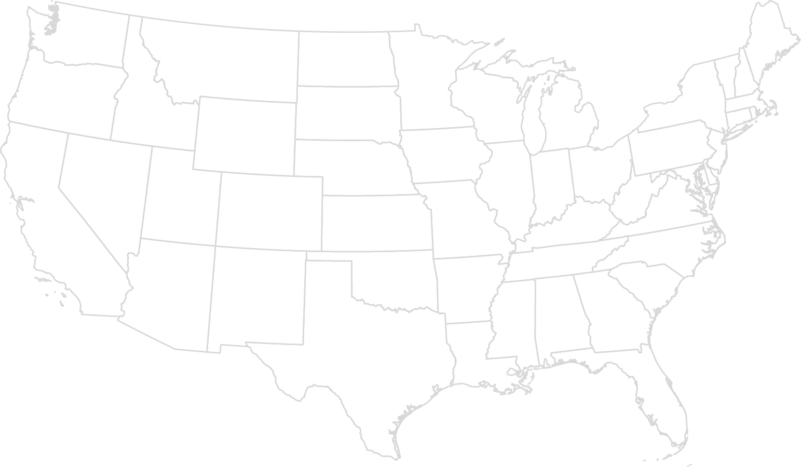


Madden | Media
GEOGRAPHIC TARGETING ACROSS PAID MEDIA EFFORTS
Kansas City
STL
Wichita
Springfield
Joplin
OKC
Fort Smith
Tulsa
Little Rock
Shreveport
Dallas
Houston
Core Markets
Key Growth Markets
Notes:
Target paid media audiences - and then national retargeting & premium publications

Slide 6
2024 Timeline
(it’s been a busy year so far!)
Month | Oct’23 | Dec ‘23 | Jan’24 | Feb | March | April | May | Jun | July | Aug | Sep | Oct | Nov | Dec
Pitch to Community
Onboarding & KBO Workshop
Creative Adjustments
Launch Digital Media with Current Creative
Launch New Creative
Quarterly Reporting Presented to CAPC and A&P
Eureka Springs Immersion
Video and Photography Production
Public Relations & Media Monitoring
Notes:
Call out changes from December

Slide 7
*Search Engine Optimization, Public Relation Efforts, and Website Optimizations are not included in the plan below, but will be supported throughout the year.
Madden | FY24 Media Calendar
FY24 Paid Media Calendar
Month | Jan’24 | Feb | March | April | May | Jun | July | Aug | Sep | Oct | Nov | Dec
Google SEM | Goal: 105,100 Clicks
Google Display |  |  | Goal: 17,957,000 Impressions
Targeted Website Banner Ads with Visitor Spend Reporting |  |  |  |  | Goal: 5,556,000 Impressions
Social Media Paid Ads |  |  | Goal: 181,581 Clicks
Geo-Fencing: Custom Audiences & Events |  |  |  |  | Goal: 3,571,000 Impressions Geofencing Key Events
Travel Endemic Media Expedia |  |  | Goal: 3,833,000 Impressions
Video: OTT/CTV (Over the Top TV / Connected TV Streaming) |  |  |  |  | Goal: 667,000 Impressions |  |  |  | Goal: 1,000,000 Impressions
Influencer Paid Partnerships
National & Regional Magazines: (National / Little Rock / Springfield / Kansas City) |  |  |  |  | Outside Mag (May/June, July/Aug) The Knot (July) |  |  |  |  | The Knot | 417 Mag (Nov, Dec) AY Mag (Nov, Dec)
In-Flight WiFi Video Ads |  |  |  |  | Goal: 10,000 Impressions
Billboards: Kansas City & Northwest Arkansas

Slide 8
What Have We Been Up To?
(A Look at Q1-Q3)

Slide 9
Creative Evolution

Slide 10




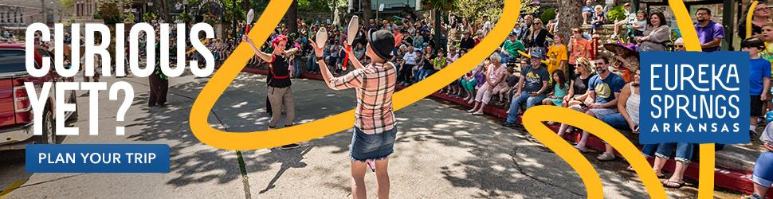
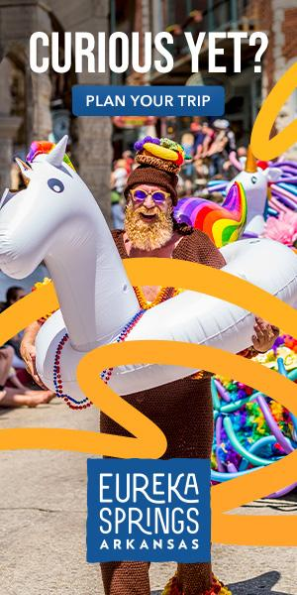


Early 2024 Creative Pivot
Notes:
It was important to get creative live & actionable as quickly as possible into 2024, so our team went straight to work finding a solution that would acknowledge “Curious, Indeed” from some transition messaging, but be more actionable

Slide 11

New Campaign Preparations
Madden Media Immersion Trip in March 2024
Account Strategy, Public Relations, Content Strategy
18 Locations
“Storytellers” Breakfast
Notes:
Team immersion trip
Blue Springs Heritage Center
Bubba’s BBQ
Crescent Hotel
East By West
Eureka Springs Historical Museum
Eureka Clothing Company
Eureka Jim
Eureka Live
Eureka Springs Coffee House
Grand Central Hotel
Missy’s White Rabbit
Mud Street Cafe
Opera in the Ozarks
Rogues Manor
Spring on Main
The Great Passion Play
Thorncrown Chapel
Turpentine Creek Wildlife Refuge

Slide 12
Madden | Our Approach
BRAND STRATEGY WORKSHOP: KEY QUESTIONS ASKED
What is it we’re selling?
What’s the emotion we’re trying to evoke?
What is the product / category or the ‘units’ of sale?
What do we know?
What is the assignment? What are we building? Output/Deliverables?
What do we want to have happen (that’s measurable)?
Who are we talking to?
What do they currently think?
What’s the one thing we need to tell them? In 7 words or less?
Why should they believe us?
What do we want them to feel as a result of seeing the communication? How do we want them to feel in our destination?
What is our personality?
In just a few words, define our attitude?
What’s the optimal media environment?
How will the channels amplify the message?
Why are we doing it?
Where will the work run?

Slide 13
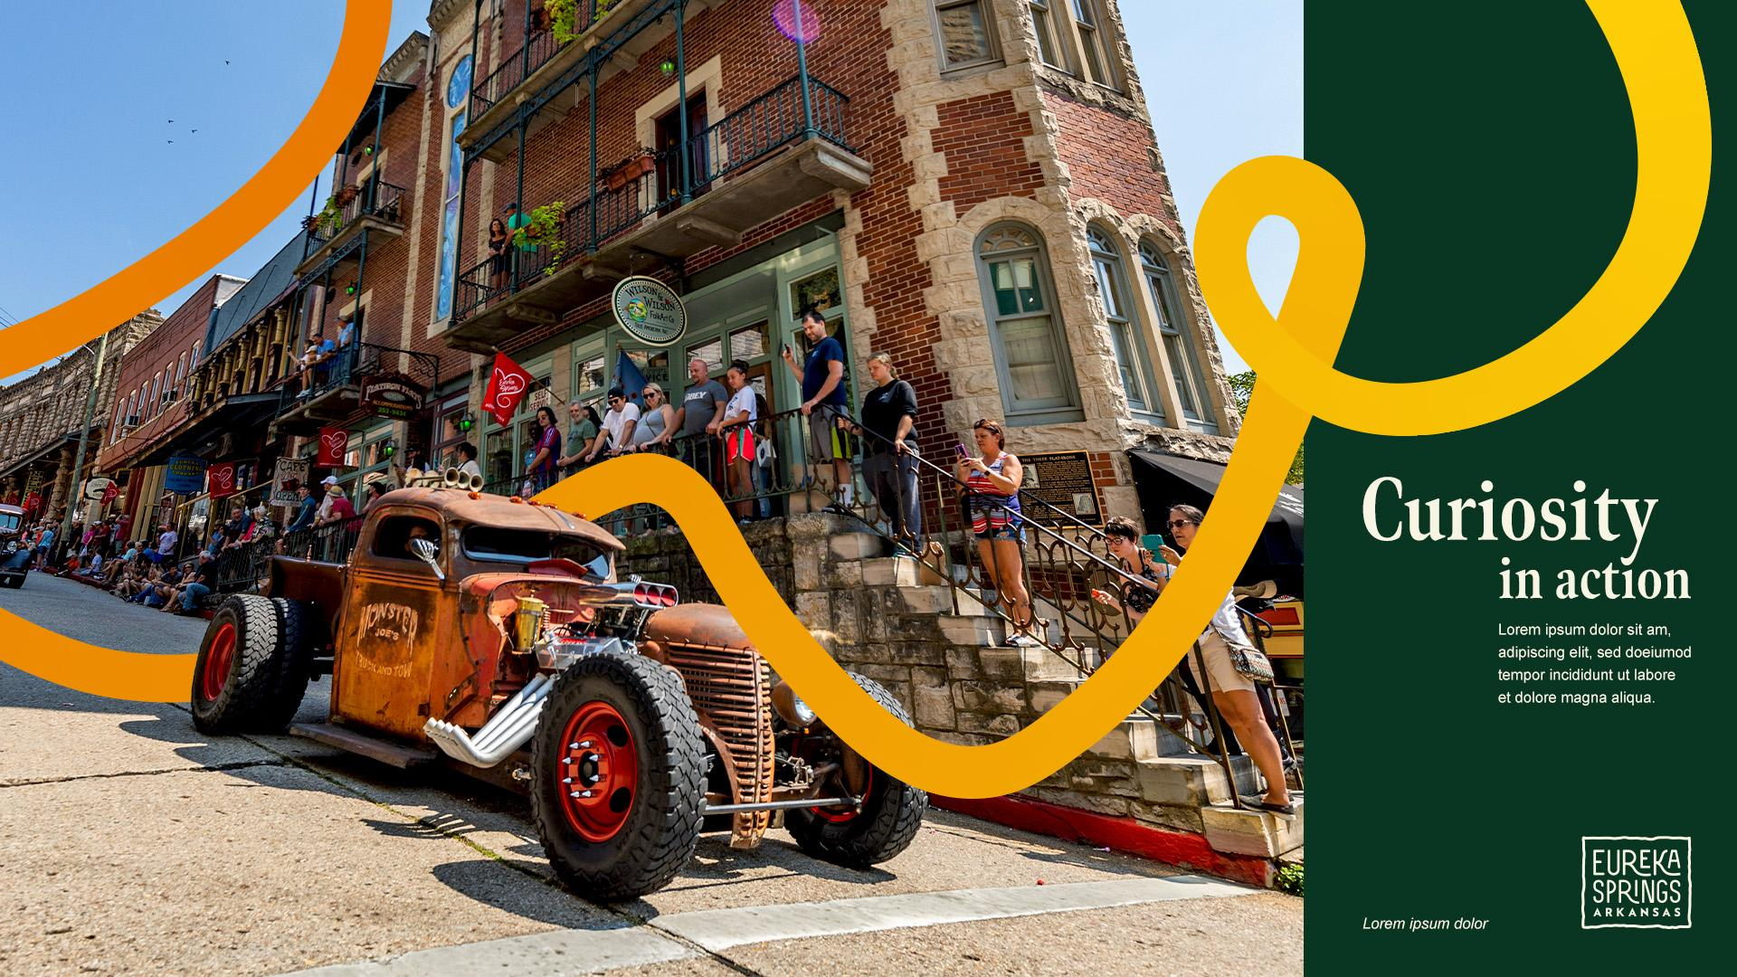
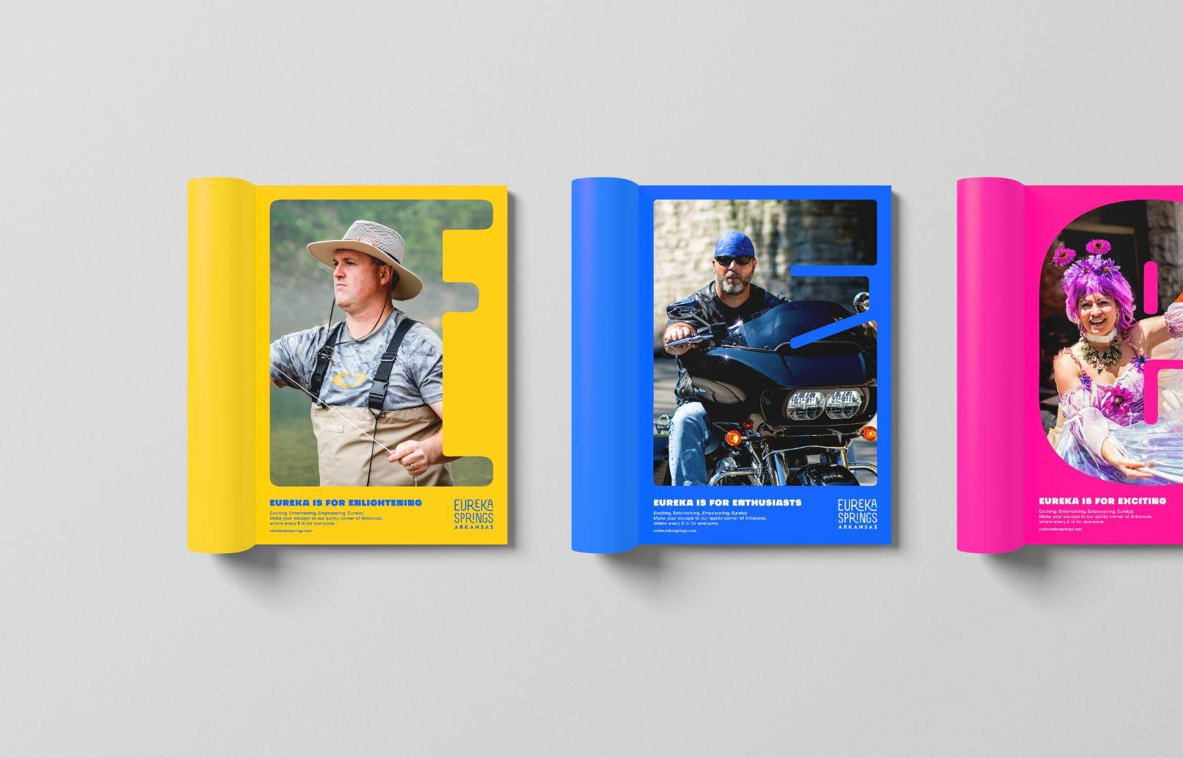


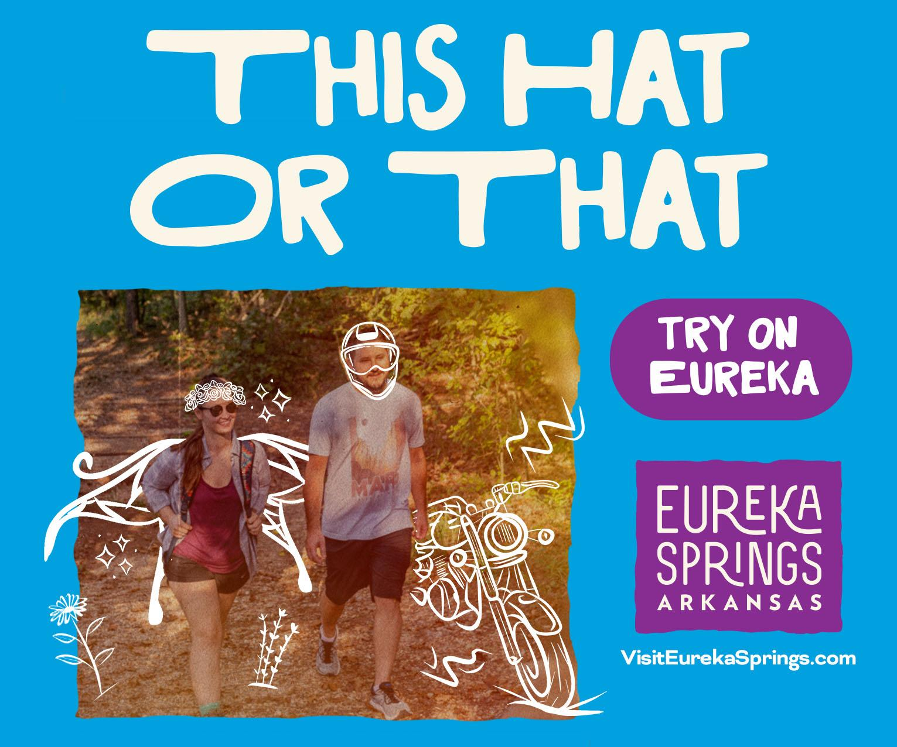
E X P L O R I N G A N E W C A M P A I G N
| 13
Notes:
After our team’s immersion in market, and a deeper creative workshop, we explored new campaign options

Slide 14
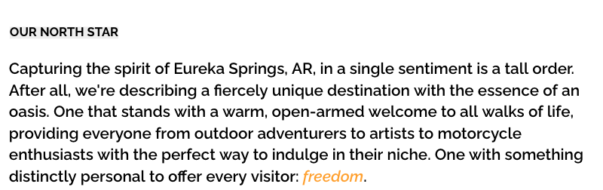

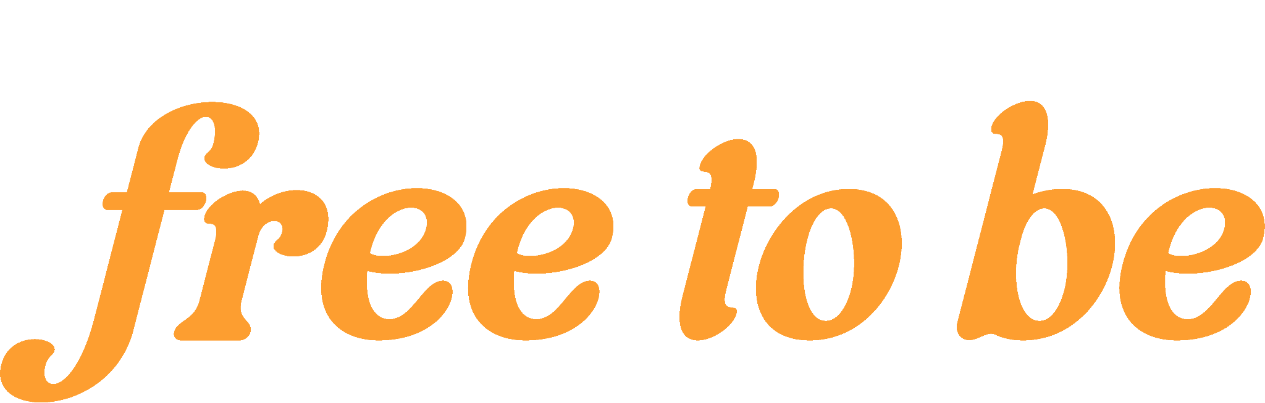
“
WHETHER YOU
WANT TO BE
YOURSELF, THE
BEST VERSION
OF YOURSELF, OR SOMEONE ELSE ENTIRELY, EUREKA SPRINGS IS
F I N D I N G O U R N O R T H S T A R
”
| 14
Notes:
Ultimately, the “Free To Be” concept was selected, a campaign that celebrates Eureka’s welcoming culture, history of rejuvenation, and boundless beauty both in nature and in heart. Our message that, “Eureka Springs is where you’re free to be,” extends a warm invitation to come experience Eureka as your most authentic self—no matter what that may mean.

Slide 15
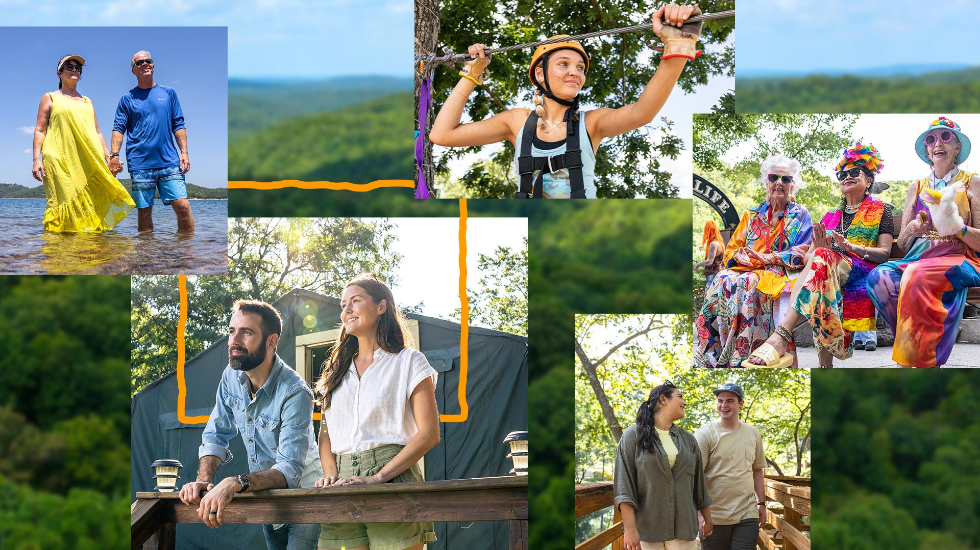
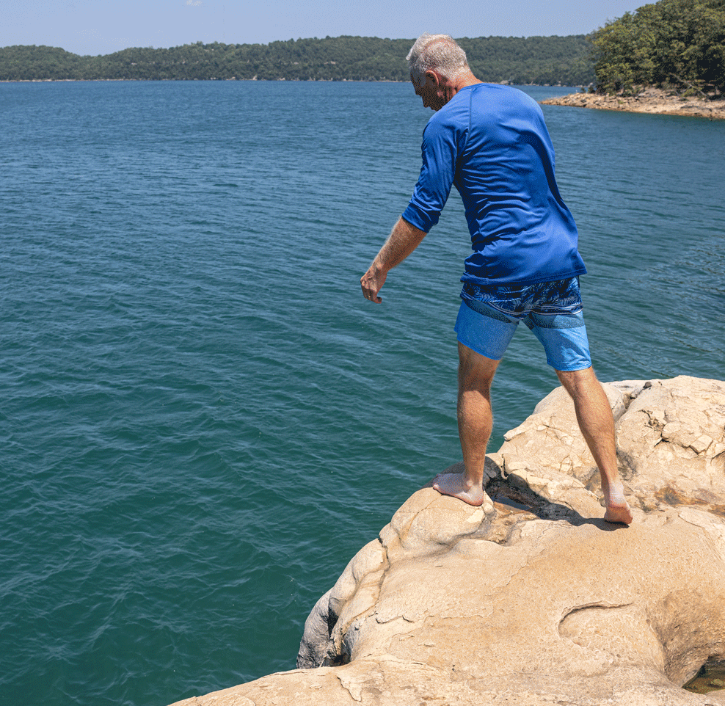
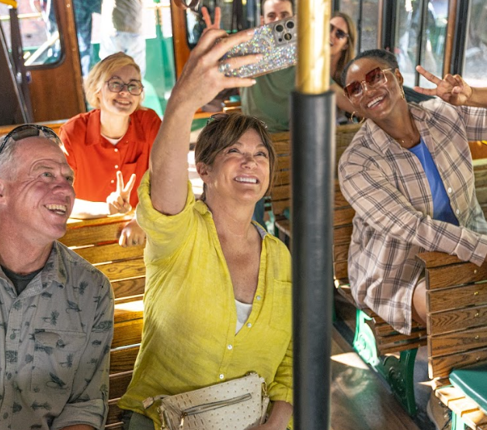
C A P T U R I N G
“O N L Y I N E U R E K A”
E X P E R I E N C E S” &
E X P R E S S I O N S
OUTDOORS
COUPLES
LEISURE
| 15
Notes:
With pillars defined, we set out to bring “Free To Be” to life, showcasing Eureka’s appeal for outdoor adventurers, leisure seekers, and couples of all shapes and sizes.

Slide 16
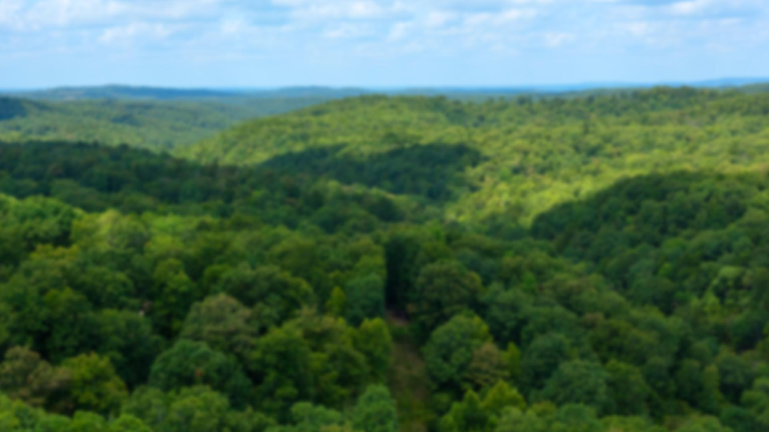
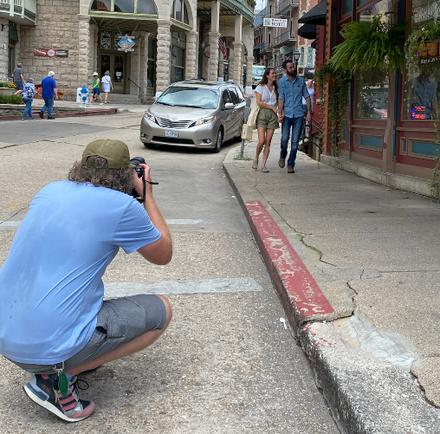
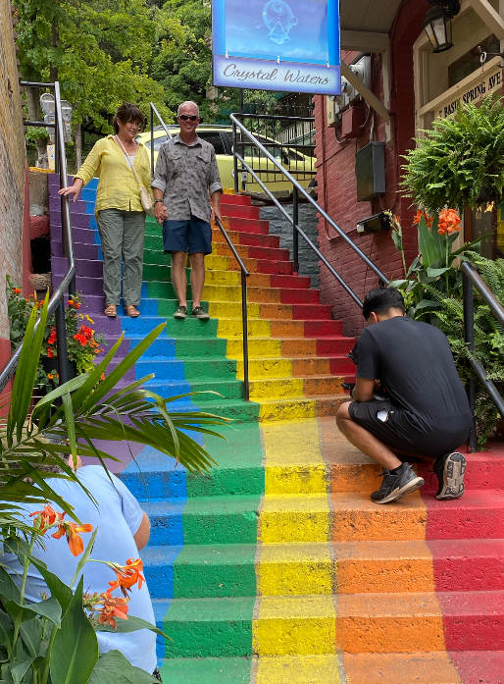
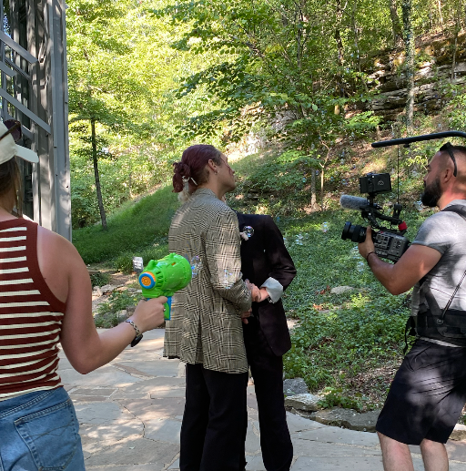
C A P T U R I N G
“O N L Y I N E U R E K A”
E X P E R I E N C E S” &
E X P R E S S I O N S
__J U L Y P H O T O & V I D E O S H O O T __
_BEHIND_
_THE SCENES_
| 16
Notes:
From behind the scenes…

Slide 17
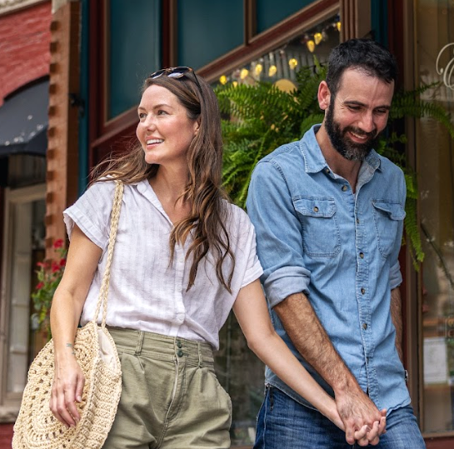
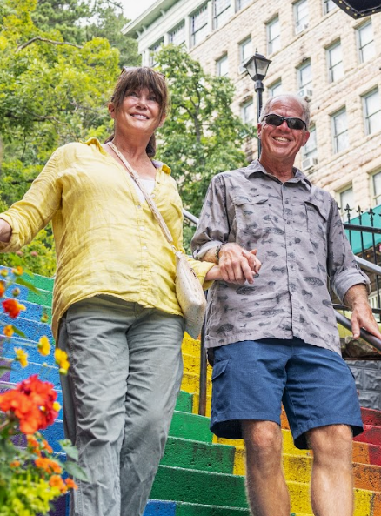
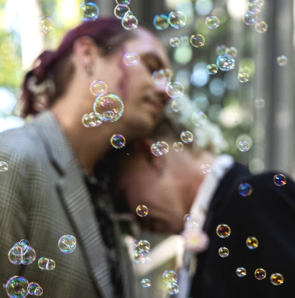
C A P T U R I N G
“O N L Y I N E U R E K A”
E X P E R I E N C E S” &
E X P R E S S I O N S
__J U L Y P H O T O & V I D E O S H O O T __
_THE MAGICAL_
_MOMENTS_
| 17
|
Notes:
…to the actual captures, we enjoyed every moment in Eureka. Shot over 2 days and 8 locations in nearly-100-degree heat, our first photo and video shoot took place this past July.

Slide 18
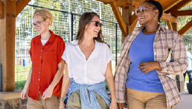
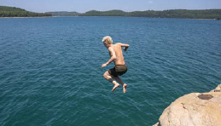
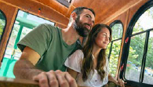
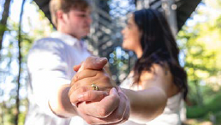
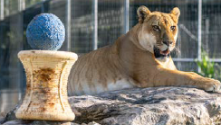
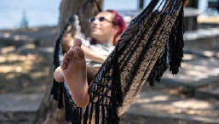
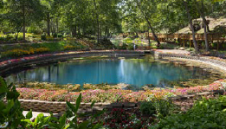
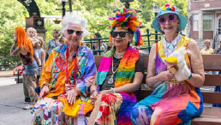
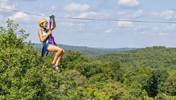
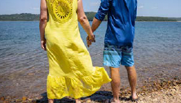
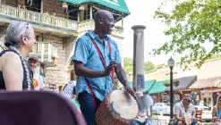
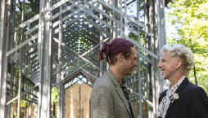
C A P T U R I N G
“O N L Y I N E U R E K A”
E X P E R I E N C E S” &
E X P R E S S I O N S
__J U L Y P H O T O & V I D E O S H O O T __
| 18
|
Notes:
From dining and dancing downtown to catching some waves to dipping a toe in an ice-cold spring, our shoot featured four different couples (including two newlywed scenes at the breathtaking Thorncrown Chapel!), an unforgettable community drum circle at Basin Spring Park, and many other “Only in Eureka” experiences.

Slide 19
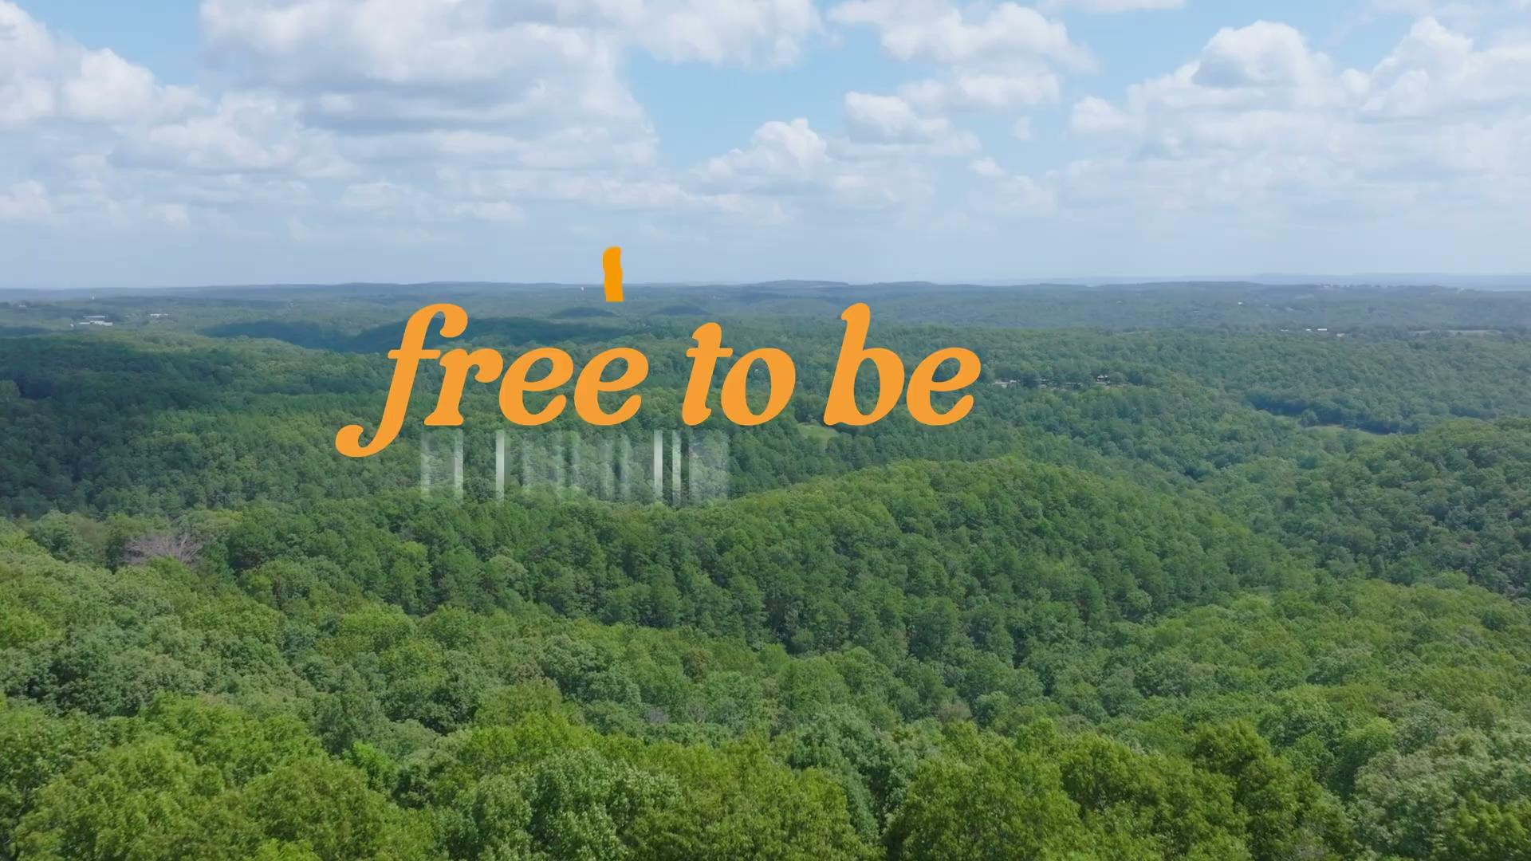
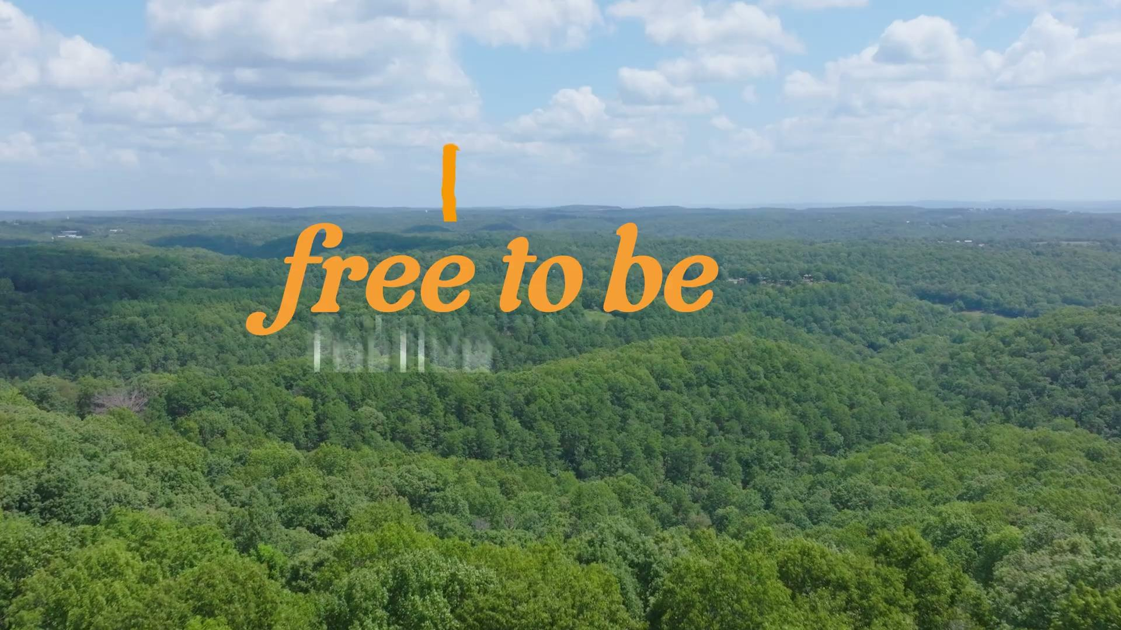
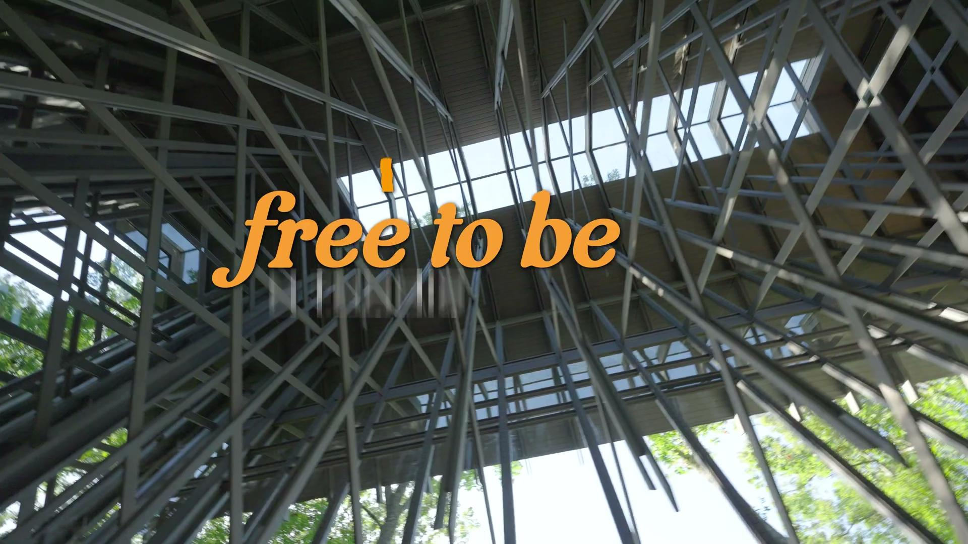
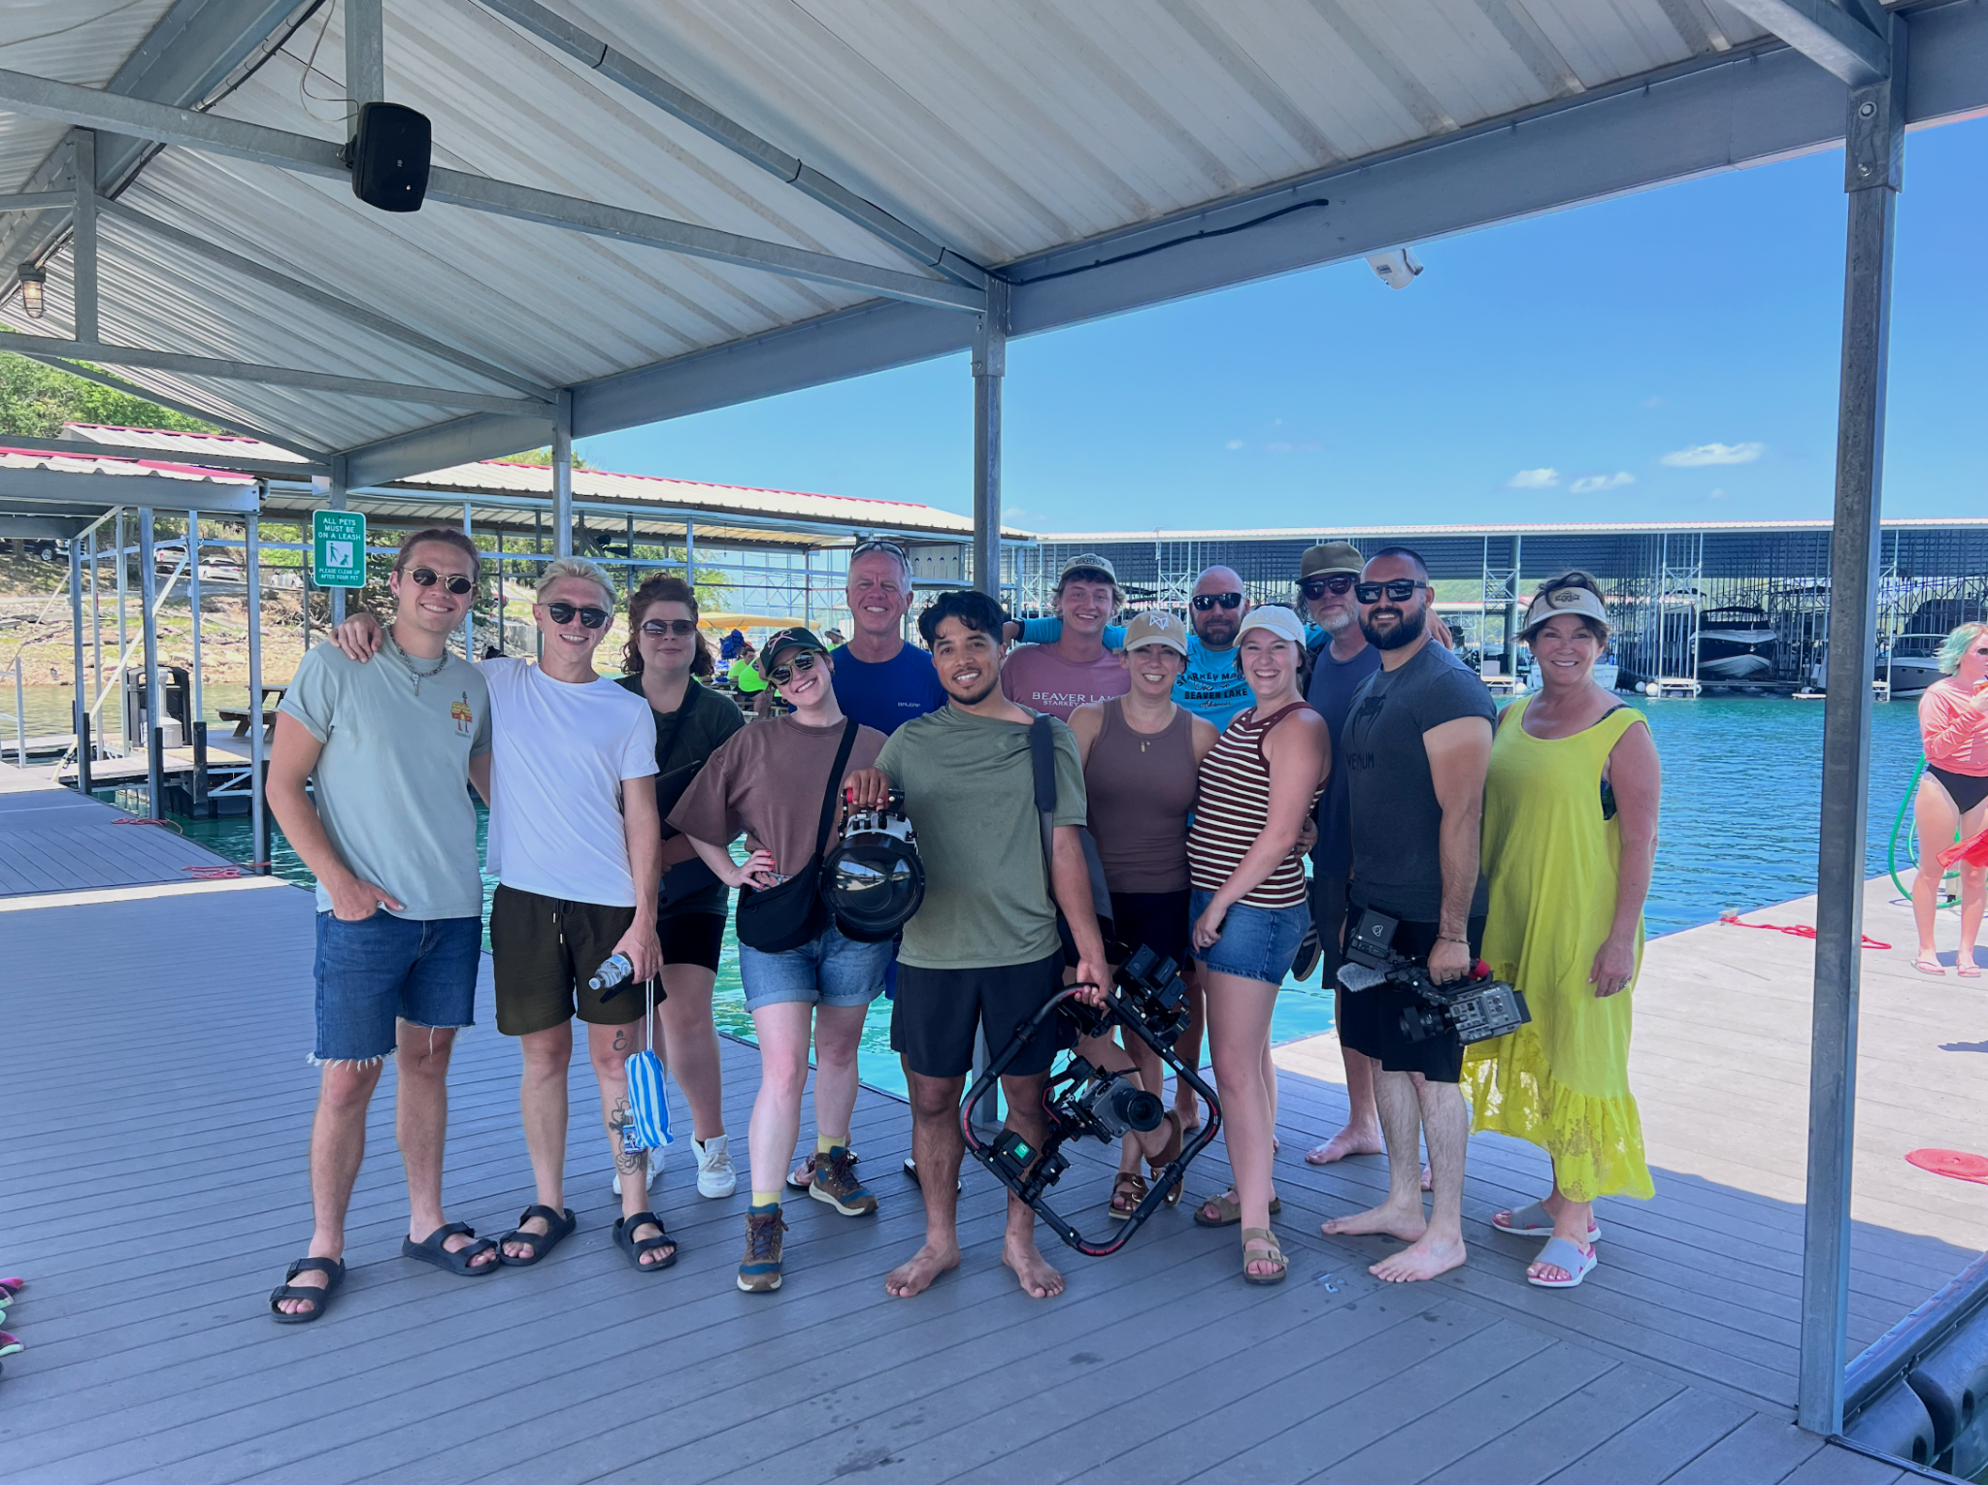

J U L Y P H O T O & V I D E O S H O O T
_:30 OUTDOORS_
_:15 OUTDOORS_
_:15 COUPLES_
| 19
Notes:
We produced our first 3 videos!

Slide 20




F R E E T O B E | C A M P A I G N O V E R V I E W
Our North Star: Free To Be
Capturing the spirit of Eureka Springs in a single sentiment is a tall order. After all, we're describing a fiercely unique destination with the essence of an oasis. One that stands with a warm, open-armed welcome to all walks of life, providing everyone from outdoor adventurers to artists to motorcycle enthusiasts with the perfect way to indulge in their niche. One with something distinctly personal to offer every visitor: freedom.
Free to Be is more than a campaign concept; it is an overarching descriptor that gets right to the heart of what folks will experience when visiting. It moves seamlessly through pillars and demographics, allowing it to be utilized in print and digital media and serving as the cornerstone of a video series showcasing Eureka's finest. Whether you want to be yourself, the best version of yourself, or someone else entirely, Eureka Springs is where you're free to be.
Our October Shoot:
While the exceptional beauty of Eureka Springs has long been established, our October video shoot gives us the opportunity to feature a direct, visual contrast between the individual allure of the changing seasons.
As an extension of our July shoot, October will not only allow us to fill in pillar gaps for a cohesive video campaign but will also—with a bit of help from nature’s autumn hues—showcase a more complete example of The Seeker’s experience in Eureka Springs.
Our goal is to capture the richness of this time of year in the deeper shades of reds
and golds, the shadows of more haunting adventures, and the uninhibited freedom that is the cornerstone of Eureka’s allure.
This footage will beautifully complement our existing sun-soaked summer captures.
Always our guide!

Slide 21
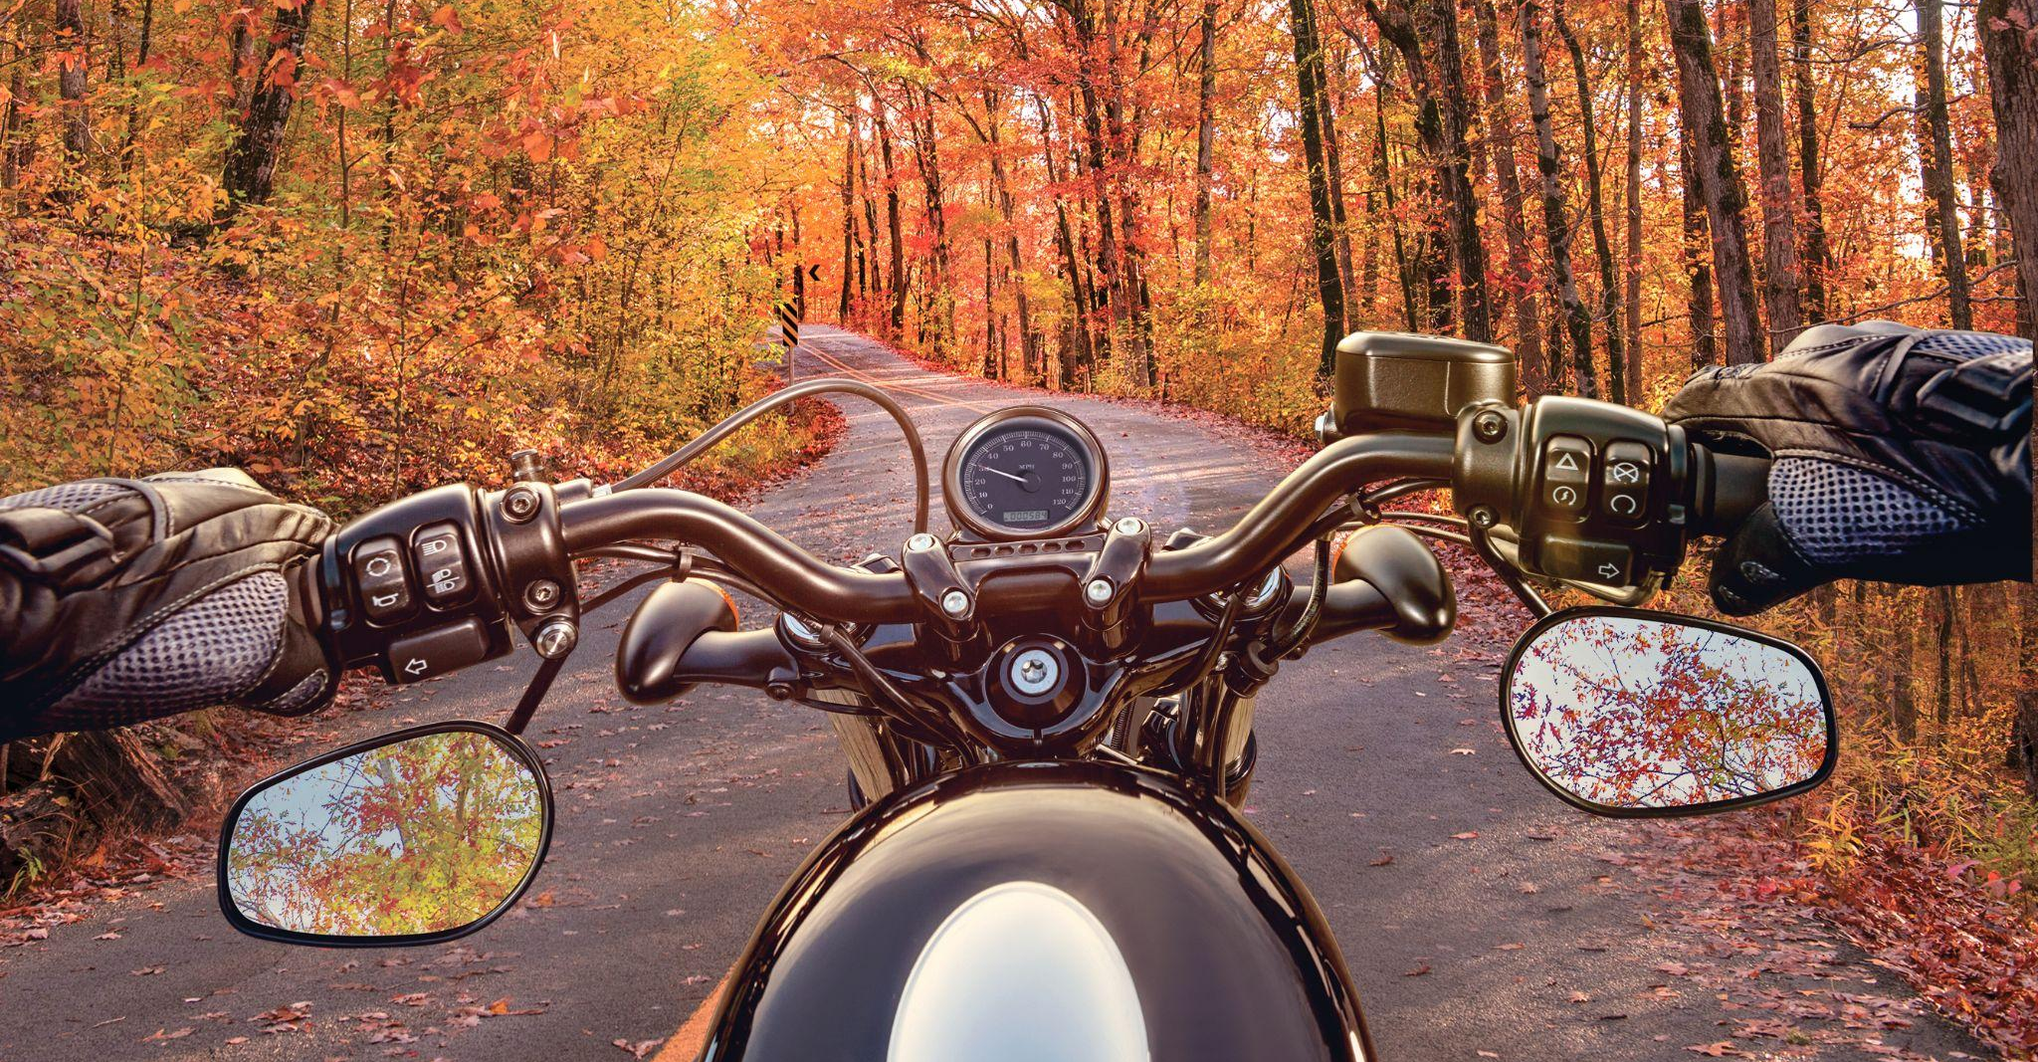
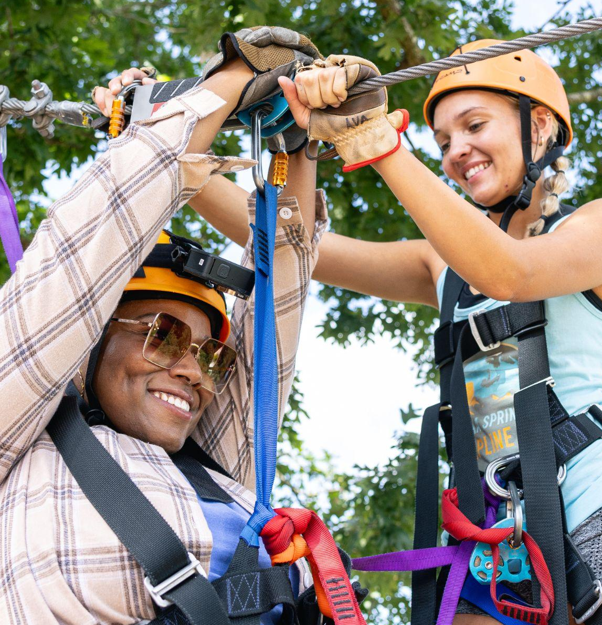
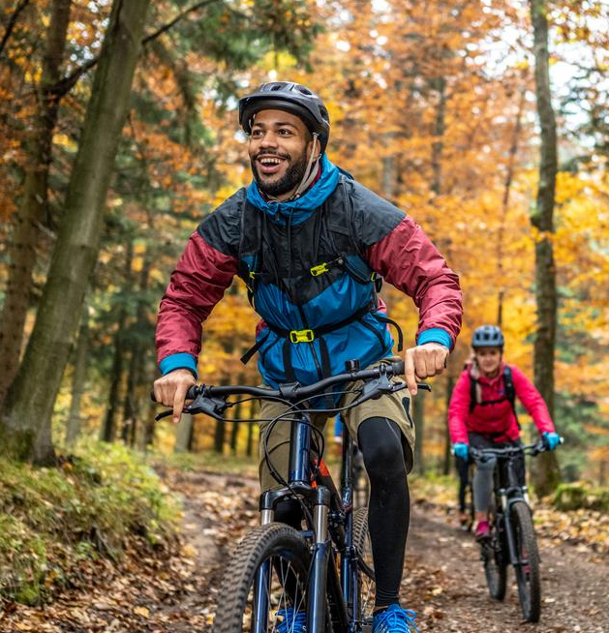
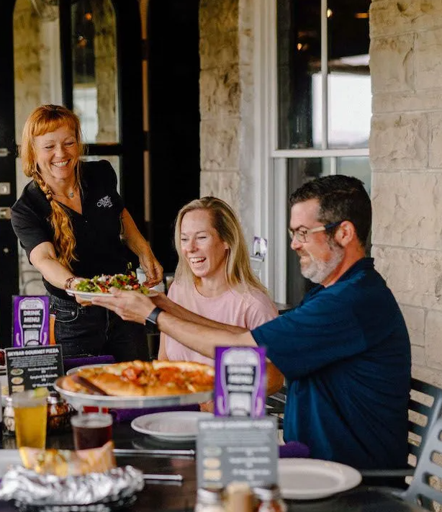
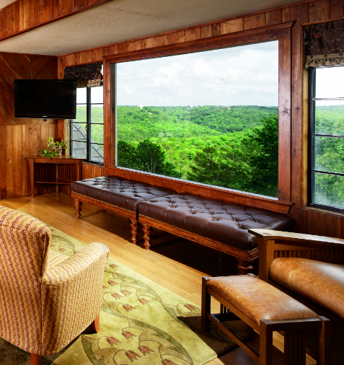
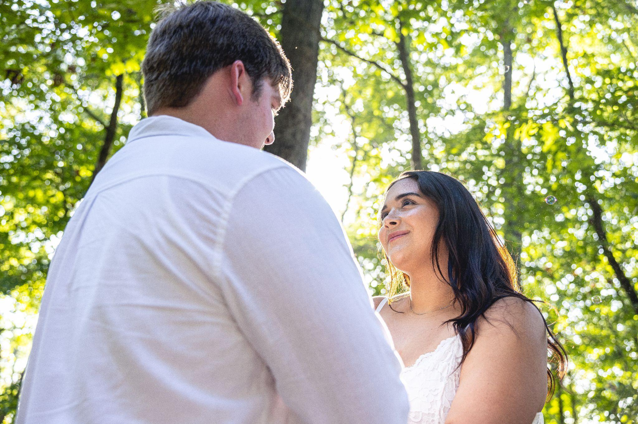
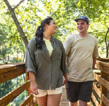
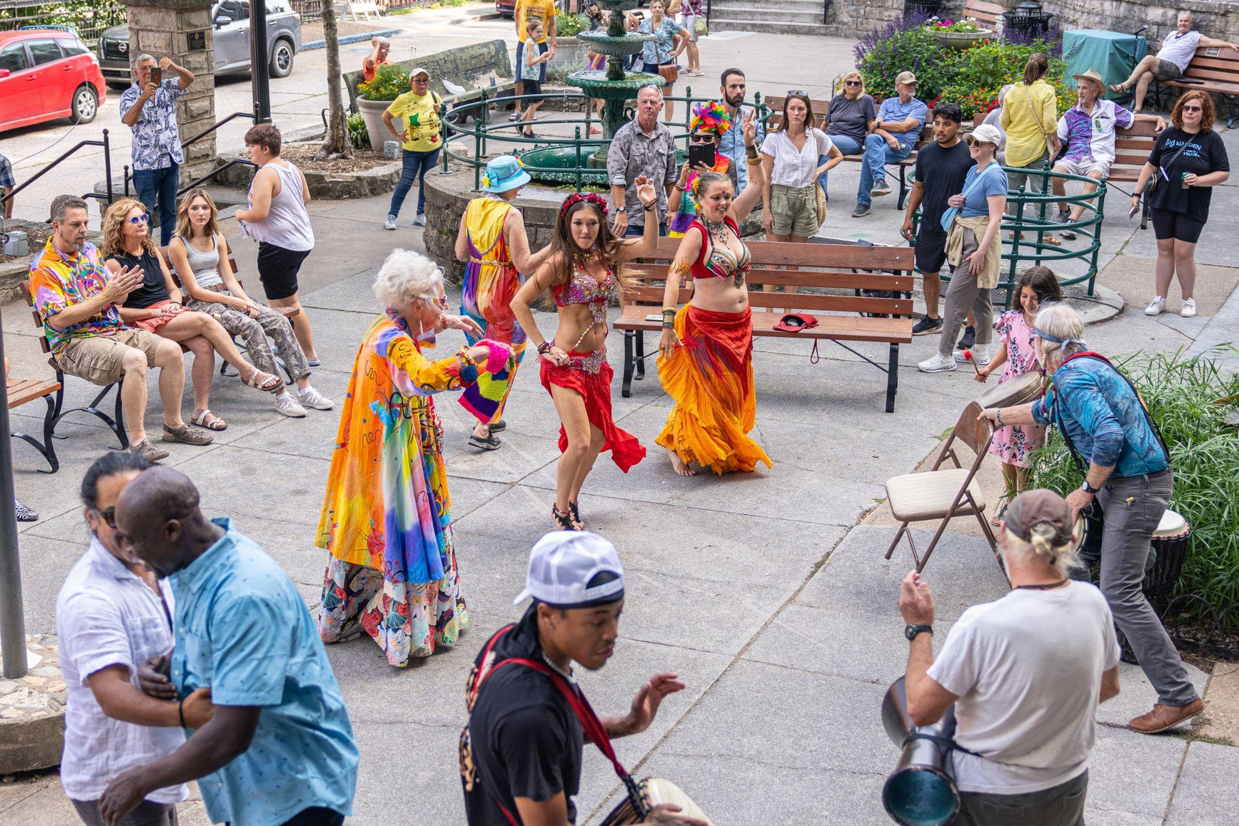
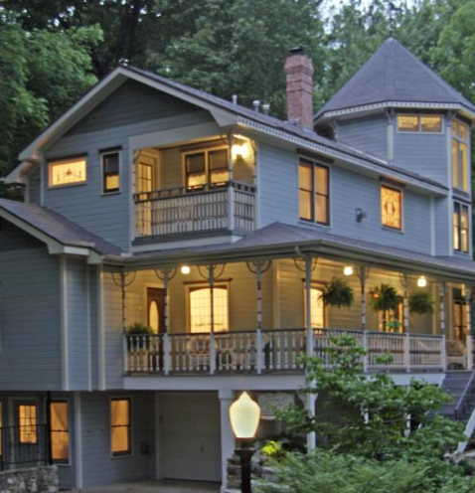
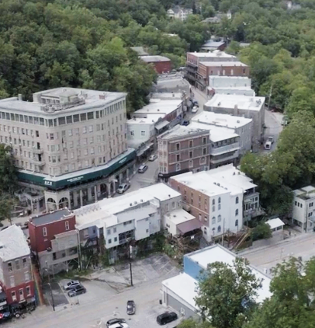
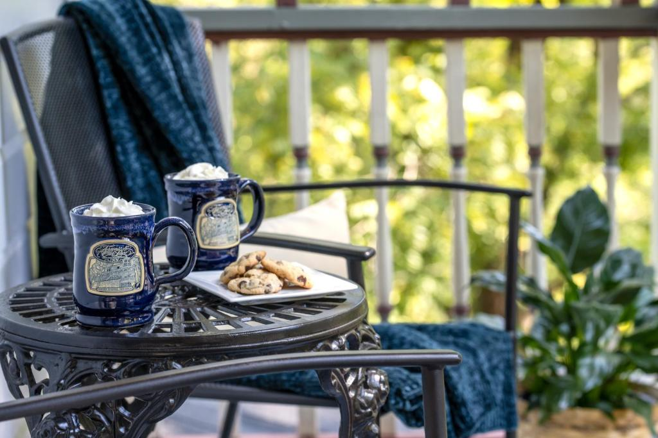
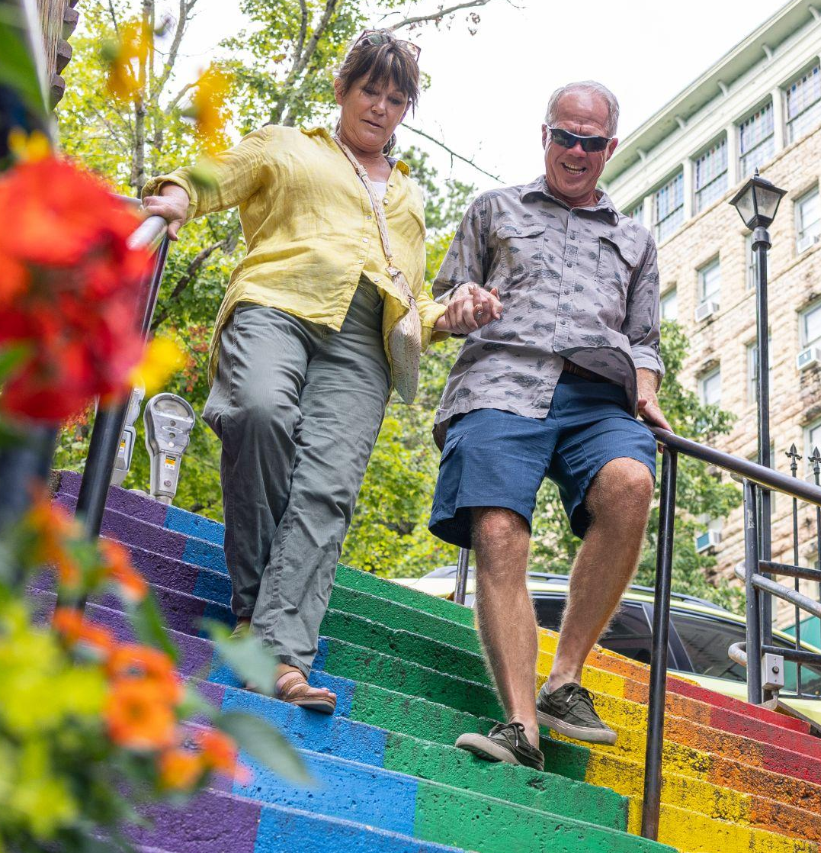

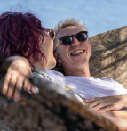
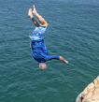
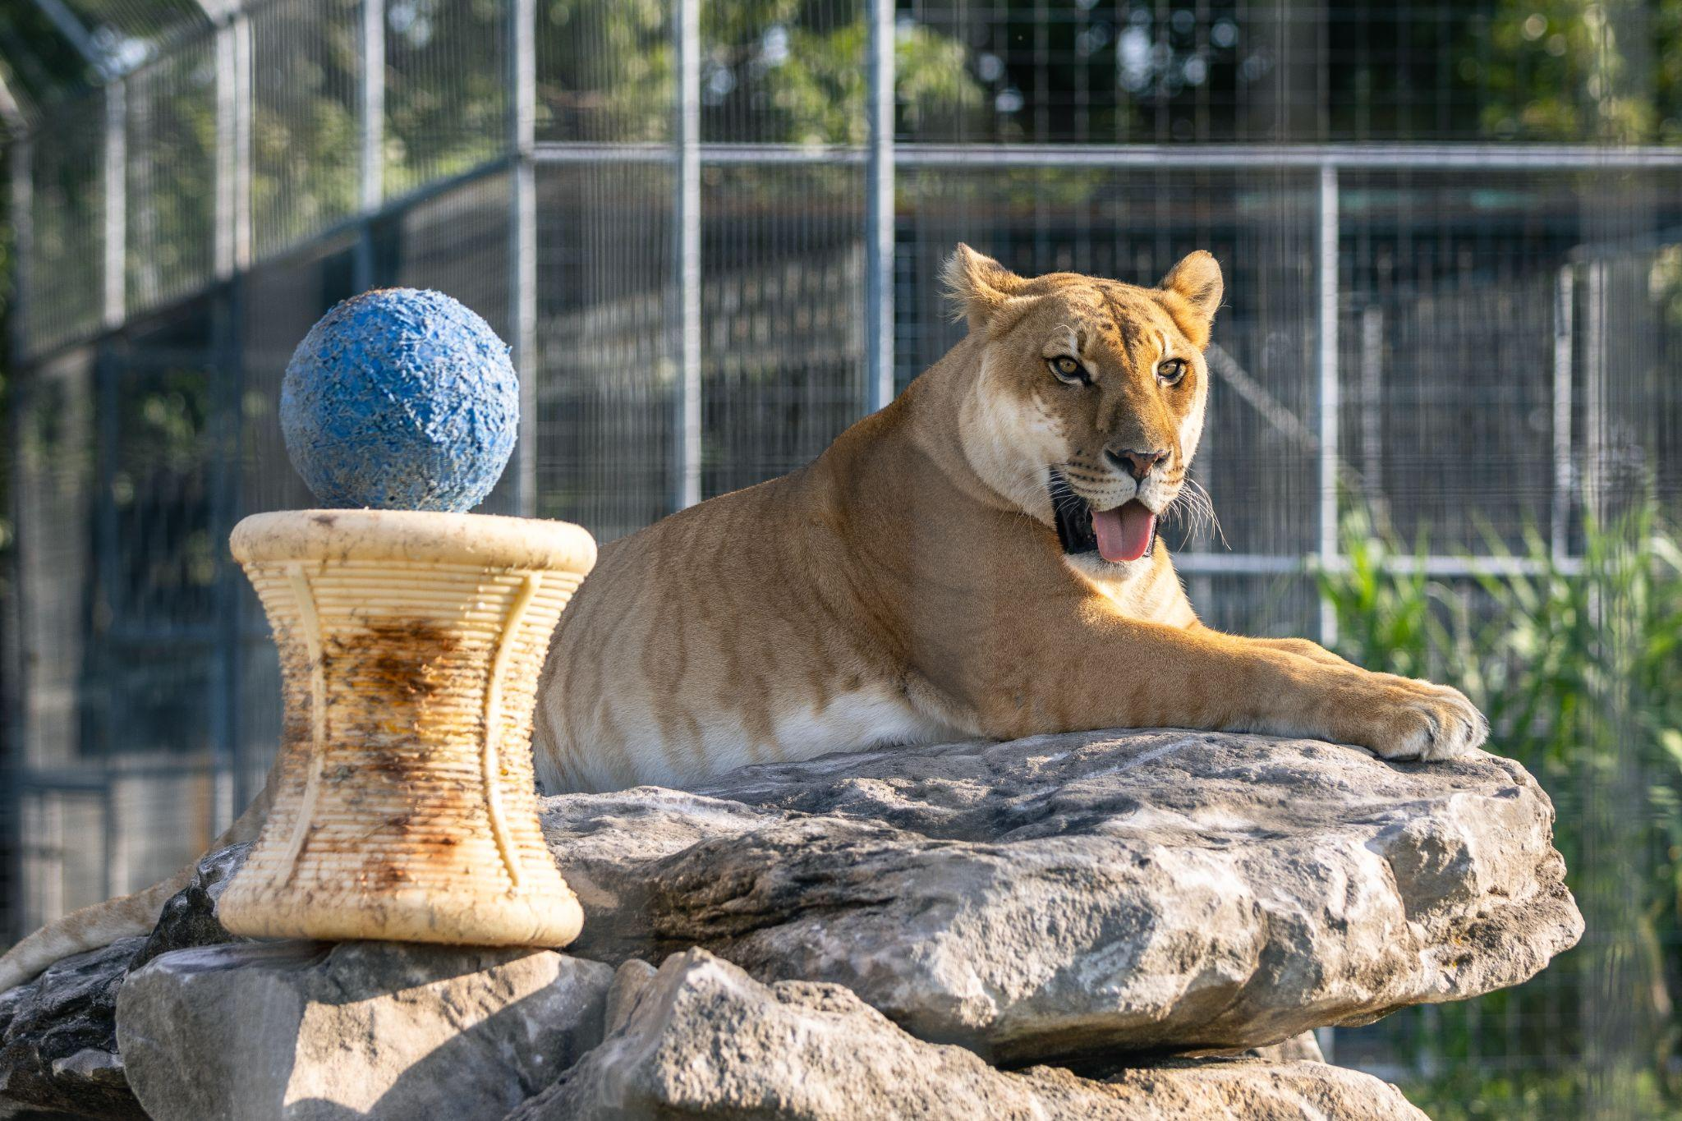






O C T O B E R P H O T O & V I D E O S H O O T
Notes:
And planned for our upcoming shoot!

Slide 22



F R E E T O B E M E M O R A B L E
Notes:
To ensure campaign consistency across all channels, our creative team crafted “Free To Be” brand guidelines, including a new audience persona, “The Seeker,” copywriting guidance, useful examples of pairing campaign visuals and messaging, and more.

Slide 23


F R E E T O B E | A U D I E N C E O V E R V I E W
OUR AUDIENCE PERSONA
“The Seeker”
A deep thinker who has wondered about their place in the world and is interested in meeting others from different walks of life to help further expand their worldview.
The Seeker is curious and soulful, in search of travel that’s rich with authentic, meaningful experiences, preferring destinations that are unapologetically themselves and proud of who they are.
Uninhibited throughout their visit, The Seeker remains open to take it all in: “What does this show me?” “What does this mean to me?”
“How does this make me feel?”
A respectful traveler, uninterested in flash or facade, The Seeker is eager to meet the memories a destination holds and be inspired to make their own.
23
Notes:
A deep thinker who has wondered about their place in the world and is interested in meeting others from different walks of life to help further expand their worldview.
The Seeker is curious and soulful, in search of travel that’s rich with authentic, meaningful experiences, preferring destinations that are unapologetically themselves and proud of who they are.
Uninhibited throughout their visit, The Seeker remains open to take it all in: “What does this show me?” “What does this mean to me?”
“How does this make me feel?”
A respectful traveler, uninterested in flash or facade, The Seeker is eager to meet the memories a destination holds and be inspired to make their own.

Slide 24


F R E E T O B E ‘ S L A T E S T
| 24
Notes:
The Knot, Arkansas Bride, seasonal swaps across Meta/Google

Slide 25



F R E E T O B E ‘ S L A T E S T
| 25
Notes:
Print, digital, and OOH in targeted Kansas City, MO, campaign — was nice to see a playful spin on existing campaign, proving that Free to Be has legs and can continue to evolve to meet future applications and target markets.

Slide 26


F R E E T O B E ‘ S L A T E S T
| 26
Notes:
Seasonal swaps to NWA billboards

Slide 27
Media

Slide 28

Madden | Media
2024 Eureka Springs Agency Plan Investment Breakout

Slide 29



Your fabulous top performers.
10,626 Clicks
1.10% CTR
68,315 Clicks
7.75% CTR
42,740 Clicks
36.24% CTR
Run dates: 3/4/24-5/31/24
Run dates: 6/1/24-8/1/24
Run dates: 1/16/24-9/30/24

Slide 30

impressive right?
11M+
Branded Impressions
568,733
Clicks
YTD Digital Performance
Jan - Sept 2024
SEM LEISURE
SEM “NEAR ME”
GOOGLE DISPLAY
GOOGLE REMARKETING
META PROSPECTING
META REMARKETING
106,780
Clicks
400,994
Impressions
26.63%
CTR
$0.30
Avg CPC
83,333
Click Goal
175%
Pacing to Overall Goal
27,058
Clicks
125,573
Impressions
21.55%
CTR
$0.43
Avg CPC
21,538
Click Goal
172%
Pacing to Overall Goal
214,479
Clicks
10,207,647
Impressions
2.10%
CTR
$1.66
Avg CPM
11,628,000
Impr. Goal
125%
Pacing to Overall Goal
143,285
Clicks
6,046,334
Impressions
2.37%
CTR
$1.89
Avg CPM
6,329,000
Impr. Goal
109%
Pacing to Overall Goal
46,709
Clicks
3,539,670
Impressions
1.32%
CTR
$0.30
Avg CPC
47,619
Click Goal
139%
Pacing to Overall Goal
18,504
Clicks
1,483,210
Impressions
1.25%
CTR
$0.69
Avg CPC
33,962
Click Goal
78%
Pacing to Overall Goal
Avg CTR: 7.41%
Avg CTR: 7.41%
Avg CTR: 2.02%
Avg CTR: 3.67%
Avg CTR 1.66%
Avg CTR 1.68%

Slide 31
impressive right?
34M+
Branded Impressions
579,369
Clicks
YTD Digital Performance
Continued
EXPEDIA
EPSILON
MOBILEFUSE
AZIRA (CTV)
INK
ARKANSAS IG TAKEOVER
3,230
Clicks
2,024,975
Impressions
0.16%
CTR
$1.5M
Gross Booking $
3,833,000
Impr Goal
100%
Pacing to Overall Goal
5,904
Clicks
5,556,174
Impressions
0.11%
CTR
$9.00
Avg CPM
5,555,555
Impr. Goal
CAMPAIGN COMPLETE
2,464
Clicks
3,860,800
Impressions
0.06%
CTR
$6.06
Avg CPM
3,571,000
Impr. Goal
100%
Pacing to Overall Goal
320
Clicks
787,197
Impressions
0.04%
CTR
$30
Avg CPM
1,667,000
Impr. Goal
100%
Pacing to Overall Goal
10,236
Clicks
17,460
Impressions
58%
CTR
10,000
Impr. Goal
CAMPAIGN COMPLETE
400
Clicks
210,677
Impressions
0.19%
CTR
115,839
Reach
$1.55
Avg CPC
CAMPAIGN COMPLETE
Avg CTR: 0.10%
Avg CTR: 0.59%
Avg CTR: 0.13%

Slide 32


2024 PUBLICATIONS: THE KNOT
Notes:
Publications:
The Knot Specs here (single full page)
Volume 3/July, due 6/7
Volume 4/October, due 9/13 Final Ad Linked Here

Slide 33


2024 PUBLICATIONS: OUTSIDE MAGAZINE
Notes:
Publications:
Outside Magazine Specs Here (single full page)
May/June Issue - The Best Outdoor Festivals. Due 4/10
July/August Issue - Come On, Get Happy / Best Beaches in the World. Due 6/12

Slide 34
DMO Tourism Industry Benchmarks
PERFORMANCE TACTIC | YOUR CTR | MADDEN BENCHMARK CTR | DIFFERENCE | YOUR COST | MADDEN BENCHMARK COST | DIFFERENCE
SEM LEISURE | 26.63% | 7.41% | 19.55% | $0.30 | $0.48 CPC | $0.18
SEM NEAR ME | 21.55% | 7.41% | 15.16% | $0.43 | $0.48 CPC | $0.05
GOOGLE DISPLAY | 2.10% | 2.02% | 0.08% | $1.66 | $1.38 CPM | $0.28
GOOGLE REMARKETING | 2.37% | 3.67% | 1.3% | $1.89 | $1.32 CPM | $0.57
META PROSPECTING (CTS) | 1.32% | 1.66% | 0.34% | $0.30 | $0.27 CPC | $0.03
META REMARKETING | 1.25% | 1.68% | 0.43% | $0.69 | $0.29 CPC | $0.40
MOBILEFUSE | 16.75% EER* | 5% EER* | 11.75% | $6.06 | $10.67 CPM | $4.61
AZIRA (CTV) | 0.04% | 0.13% | 0.09% | $30 | $30 CPM | FLAT
*Expandable engagement rate for rich media expandable ad.
Notes:
Our tactics that are performing below our benchmarks just launched in March - so we expect to see these number improve as the campaign ramp.

Slide 35
Let’s take a deep dive.
BIG WINS
WHAT’S WORKING
General Leisure & Near-Me SEM Campaigns:
By implementing general leisure and near-me campaigns this year, we've significantly enhanced our ability to engage users actively searching in and around Eureka Springs. These campaigns have become the leading drivers of traffic to your website, with Paid Search seeing a 404% increase in users jumping from 30,173 to 154,923 this year, and a 264% increase in engaged sessions with 108k this year compared to the same period in 2023. These efforts are effectively reaching users interested in all things Eureka Springs—whether it's an out-of-state traveler planning their next trip or a local looking for a weekend event.
Display:
This year, your responsive display ads delivered standout performance, generating nearly 80k clicks and an impressive CTR of 2.25%. These ads accounted for 78% of total impressions and 83% of total clicks in your prospecting and responsive campaign. By allowing us to tailor messages more effectively, these ads are clearly resonating with your target audiences, as demonstrated by their strong engagement and performance.
Core Media + Innovative Tactics:
This year, our core strategies in paid search and Meta remain strong, while we’re seeing a growing user presence on emerging platforms like Ink, Mobilefuse, and Expedia. This trend is evident in your analytics, where key metrics such as total users, sessions, engaged sessions, and engagement rate have all increased compared to the same period in 2023
.
Additionally, placements in print media and OOH billboards are boosting brand awareness and keeping your destination top of mind for viewers.
Driving Conversions on Your Site:
We’ve demonstrated our ability to drive valuable, engaged users to your website through various media tactics. Now, let's shift our focus to converting those users. Let's revisit your Google Analytics goals and review how they align with conversions in Google Ads.
TOP PERFORMING
OPPORTUNITIES

Slide 36
Analytics

Slide 37


Google Analytics Breakdown
Engaged Sessions, by Month (YoY)
Insights:
Overall, volume and engagement to the site are seeing growth YoY.
The months of May and June saw the strongest growth in Engaged Sessions YoY.
Considering Madden began its marketing efforts in early 2024, we expected there to be some ramp up time.
  Early 2024 slightly underperformed, but as we made our way into Spring/Summer we saw the site really take off.
An average session duration of 3 minutes, 28 seconds is healthy and showcases that users are diving into the site.
Source: Google Analytics 4; Jan 1 - Sep 30, 2024

Slide 38

Visitation & Website Performance Index (DMA-Level)
Chart is sorted by descending # of 2024 visitors.
Sources: Azira & Google Analytics 4
Date Range: 1/1/2024 - 9/30/2024 vs. 1/1/2023 - 9/30/2023
Notes:
An index score of 100 indicates consistent performance with 2023. 2023 is the baseline year for this index. An index score > 100 indicates stronger performance in 2024. An index score < 100 indicates underperformance in 2024.
Website sessions from 8 of the top 10 DMAs are showing growth YoY with the exception of OKC (Index = 96) and St. Louis, MO (Index = 61)
LOS among regional visitors is less in 2024 than 2023, however we are seeing significant growth in volume YoY.
Sometimes as our sample size increases, we expect engagement to decrease or regress to the true mean. Meaning, let’s not panic and understand that growth in day trips from regional markets can be attributed to events and other factors.
OKC, DFW, Wichita-Hutchinson, and STLMO all see stronger LOS in 2024 compared to 2023.

Slide 39
Search Engine Optimization

Slide 40

SEO YTD 2024 Updates
Calibrating Pages for Users & Bots
Despite a decrease from 2022 numbers, 2023 is seeing a recovery and continuing to increase in clicks, impressions, and average positions. In addition to Madden’s regular monthly optimizations, we’ve worked on the following:
Redirects from Old Domain to New: In Spring 2024, Madden implemented page-level redirects from eurekasprings.org to visiteurekasprings.com, which allowed for capturing lost backlinks and directing keywords toward the pages that needed them most.
Assisting Content Strategy. Madden also performed a keyword GAP analysis to identify topic opportunities for th blog, as well as looking at new ways to optimize the “Things to Do” page and the “Events” page.
In Progress: Inlink Optimizations. Due to current layout constraints, some blogs have the opportunity to receive more inlinks through a designated “blog” page. We’re in the process of getting an SEO-friendly version ready.
URL Clicks
166K
URL Impressions
4.9M
Avg. CTR
3.4%

Slide 41
Website Updates
Notes:
Improvements to Calendar
Improvements to Discoverability
Improvements & What has been done.

Slide 42
Web Sprints
What We’ve Done So Far:
Calendar Integration
Template Clean Up
Page Speed Increase
General Maintenance
More to Do!
Meetings & Conventions
  Create a mini hub on the website for group travel planners.
  A sales tool for Jana
Promoting The Aud
  Creating a microsite within the current website
  Sharing the history
  Increasing ticket sales
Notes:
Improvements to Calendar
Improvements to Discoverability
Improvements & What has been done.

Slide 43
Public Relations

Slide 44











Public Relations: Secured Earned Media
So far in 2024, Madden Media focused in on our core pitching angles to produce high-level coverage for Eureka Springs. Madden identified 95 pieces of coverage, with Madden assisting for 18 of those placements.
Year-to-Date Madden-Generated
Placements:
18
Readership:
155.3M
AVE:
$1,436,766.10
Social Shares:
5,788

Slide 45
Public Relations: Secured Earned Media
TravelPulse Every State's Best March Events in 2024
Readership: 251,817 AVE: $1,423.73
The Travel Coolest Towns In The Ozarks For A Summer Vacation In 2024
Readership: 1,952,146 AVE: $16,824.15
Lonely Planet The coziest small US towns to visit this fall
Readership: 3,715,729 AVE :$34,370.49
Midwest Living Dine in a Cave, an Orchard or Even a River at These Unforgettable Ozarks Restaurants
Readership: 370,722 AVE: $3,429.18
TravelPulse The Most Iconic Hotels in Every State
Readership: 274,060 AVE: $1,423.73
Southern Living 25 Affordable Family Vacations You Haven't Thought Of Before
Readership: 15,823,211 AVE: $120,751.73
Southern Living Mark Your Calendars: These Are The 8 Longest Yard Sales In The South
Readership: 15,823,211 AVE: $120,751.73
Forbes Lovely Lavender Fields To Check Out The 2024 Bloom
Readership: 87,519,063 AVE: $921,503.08
StyleBlueprint Why You Need to See Eureka Springs Architecture
Readership: 128,268 AVE: $1,524.83
TravelPulse The Most Iconic Hotels in Every State
Readership: 274,060 AVE: $1,423.73
TravelPulse Best Fair Weather Fall Getaways
Readership: 153,917 AVE: $1,423.73
TravelPulse Every State's Best September Events in 2024
Readership: 153,917 AVE: $1,423.73
Matador Network Glamp with Tigers at this Wildlife Refuge in the Ozarks
Readership: 813,268 AVE: $5,077.70
Southern Living Beat The Game Day Crowds With Getaways That Are Close To Your Favorite College Towns
Readership: 13,054,241 AVE: $120,751.73
Travel Pulse Every State's Best June Events in 2024
Readership: 274,060 AVE: $1,423.73
TravelPulse Every States Best October Events 2024
Readership: 153,917 AVE: $1,423.73
Garden & Gun Seven Southern Getaways Sitting Right on Hiking Trails
Readership: 438,106 AVE: $4,403.72
Men’s Journal, 52 Fall Weekend Trip Ideas to Make You Fall in Love with Fall
Readership: 8,368,827 AVE: $77,411.65

Slide 46



Public Relations: Quarterly Newsletters
The Madden PR Team has written, designed and sent out three of your quarterly newsletters to our curated media list to spark interest in Eureka Springs in a variety of ways.
Q1 Newsletter: A Curious Case of Eureka Springs
Open Rate: 77.2%
Q2 Newsletter: Romantic Outdoor Adventure
Open Rate: 66.9%
Q3 Newsletter: The Festive Season
Open Rate: 76.5%

Slide 47
Public Relations: Press Trips
Previous Press Trips
Brian Cicioni - USA Today, Travel + Leisure, InsideHook, Fodor’s: April
Heide Brandes - Freelance, BBC, HuffPost, Southern Living, Cowboys & Indians, Business Insider, Travel Awaits: June
Nicky Omohundro - Freelance and Blogger, Little Family Adventure, Outdoor Families Magazine: June
Matt Kirouac - Thrillist, BBC, Travel + Leisure, AFAR, TripSavvy, Conde Nast: June
Upcoming Press Trips
Trudy Haywood Saunders - Southern Living, Travel + Leisure, Thrillist: November
Anne Rodriguez Jones - Architectural Digest, Travel + Leisure, Washington Post: December
Erica Zazo - Backpacker, Outside, CNN Underscored, CNN: June Pride Weekend

Slide 48
Influencers

Slide 49


@ADVENTURESINMOMLIFE_ X EUREKA SPRINGS
In Market: May 27-29, 2024
Deliverables:
Instagram Stories
1 Instagram Reel
1 TikTok Video
Metrics:
14 posts
41,045 Impressions
790 Engagements
644,600 Potential Reach
271 Saves
1.5% Instagram Engagement Rate
3.8% TikTok Engagement Rate
$2,341 Total Media Value

Slide 50
Looking Ahead into 2025

Slide 51
Madden | Creative
CONTINUING OUR MOMENTUM
Focus areas for 2025
Leaning into Audience Messaging for the Following:
  Weddings
  Nightlife
  Mountain Biking
  Group Travel
Paid Media Foundational Strategies for 2024:
  Foundational Digital: SEM + Google Display, Meta Prospecting + Remarketing
  Travel Endemic (Booking Sites)
  OTT/CTV
  Influencers
  Billboard Presence Year-Round
Notes:
Partnership Effectives;
Guidance of key partners
Project mgmt

Slide 52




Eureka Springs!

Slide 53
Q & A

